Slide 1
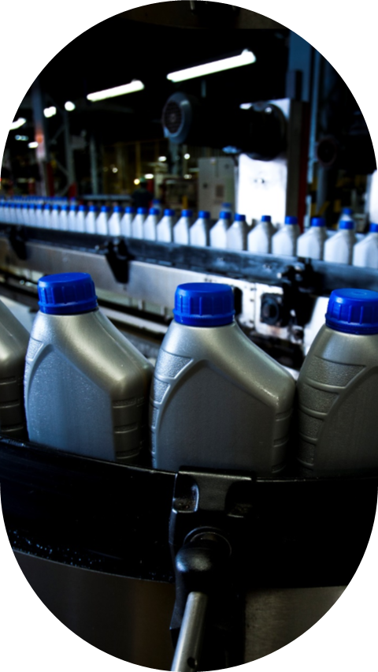

MOOVE EUROPE’S
MEETING CULTURE

Slide 2


“Great Meetings mean Great Results!”
…and great meetings do not happen by accident. Effective meetings start with protocol to ensure we have Purpose, Preparation and a Productive Outcome.
At Moove, we consider the following 8 Guiding Principals to be at the core of Every Meeting…

Slide 3








MEETING LINKS SENT AND ROOMS BOOKED
A CLEAR OBJECTIVE
ASSIGNED RESPONSIBILITIES AND ROLES
BE ‘PRESENT’
MOOVE’S 8 MEETING PRINCIPALS
CHECK AVAILABILITY
OUTPUT AND FOLLOW-UP
TIME MANAGEMENT & RESPECTING TIME ZONES
CONTINUOUS IMPROVEMENT

Slide 4
Every meeting should have a defined purpose and a clear objective- shared in advance, with a structured agenda at least 24 hours beforehand…as well as a ‘pre-read‘ of information where possible. Always ask ; ‘Could this be handled by Teams, Email or WhatsApp chat suffice, instead of a meeting?’
Organiser/Chair – Leads the meeting, keeps it on track and on time, and ensures the right people are invited.
The Note-Taker – Captures key points, decisions and actions in a shared tracker. Consider recording the meeting or using Teams tools like Transcribe or Loop for summaries.
Attendees –Expected to contribute constructively and complete their assigned actions.
The Organiser/Chair should check availability of the attendees - use Scheduling Assistant in Outlook or Teams where possible. Try to avoid ‘last minute’ cancellations and respect your colleagues' diaries. Attendees should respond promptly and flag any conflicts etc.
Meetings should start and end on time. Use practical durations such as 25/55 mins to allow transition time, and schedule ‘speedy meetings’ for quick decisions to be made. Remember to consider different time zones and lunch lunchbreaks. UK 12-13.00/13-14.00, France 12-13.00, Spain 14-15.00, Portugal 13-14.00 - all local time

Slide 5



Ensure meeting links are sent and rooms booked in advance and cancel rooms that are no longer required. Use the room you booked to avoid delaying your colleagues who are waiting for their space…
Be Present. Laptops and phones away, Turn On your cameras – and make sure remote participants can hear and engage properly during hybrid meetings. Use your own notes , recordings or shared summaries for recaps.
Share basic minutes & actions within 48 hours, ideally with deadlines. Flag any misalignments immediately. . Use a shared tracker on SharePoint that everyone can update and review progress before next meeting. Tools like Excel or Monday.com help keep actions clear. Escalate issues or blockers when needed.
Regularly seek feedback on meeting effectiveness. Combine meetings when possible and challenge reoccurring meetings that lack purpose. Share best practice of successful formats and tools across teams.

Slide 6


These Principals Emphasise our Culture in 2026
Think together.
Make choices.
Act quickly.
Sell more and better every day!

